Slide 1

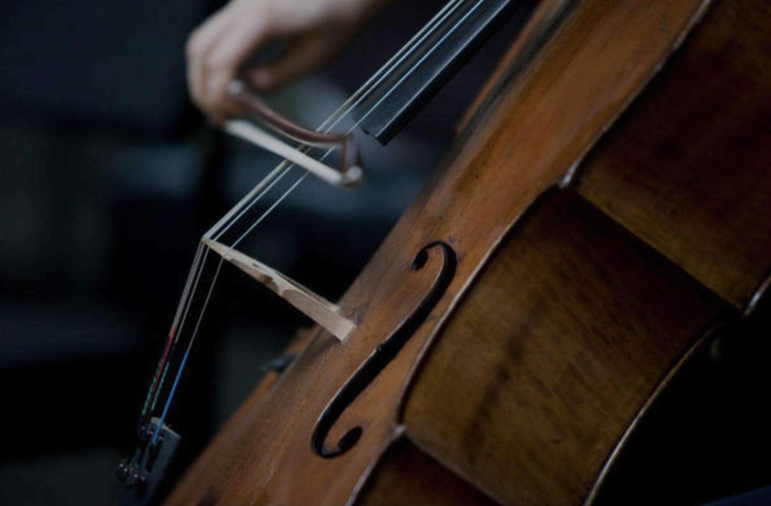
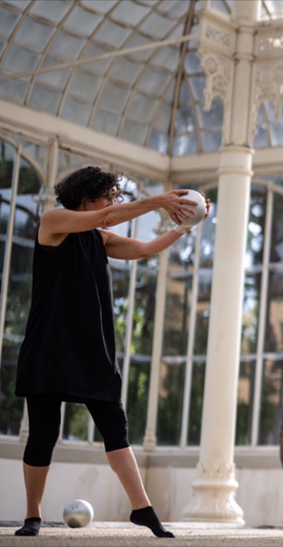
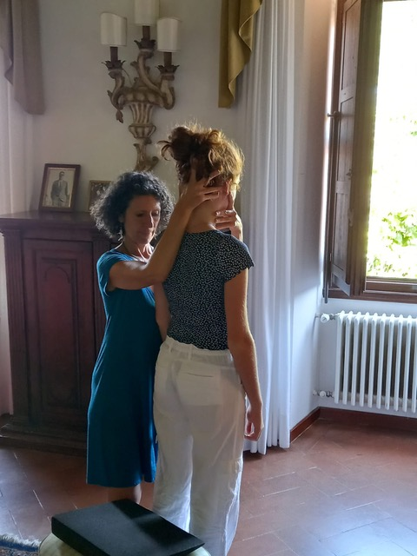
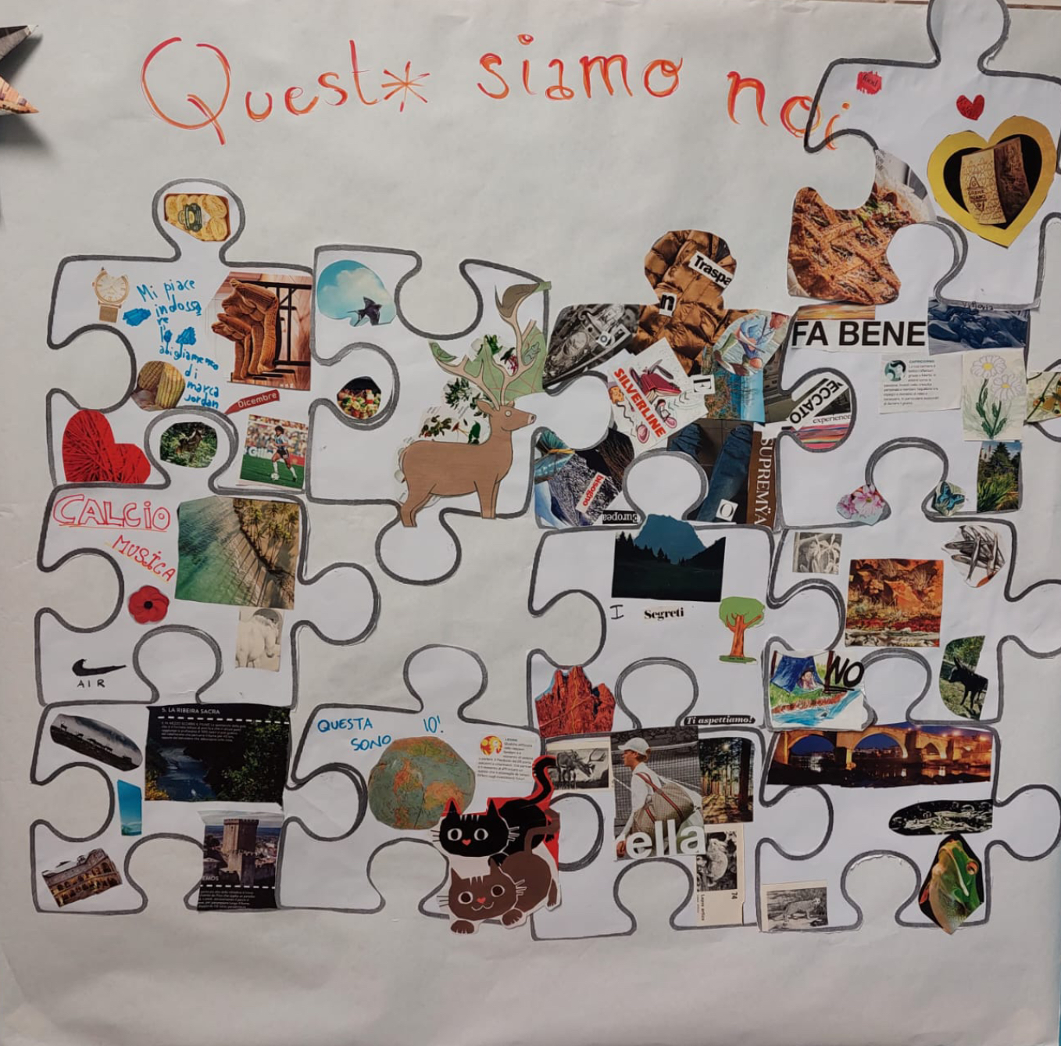
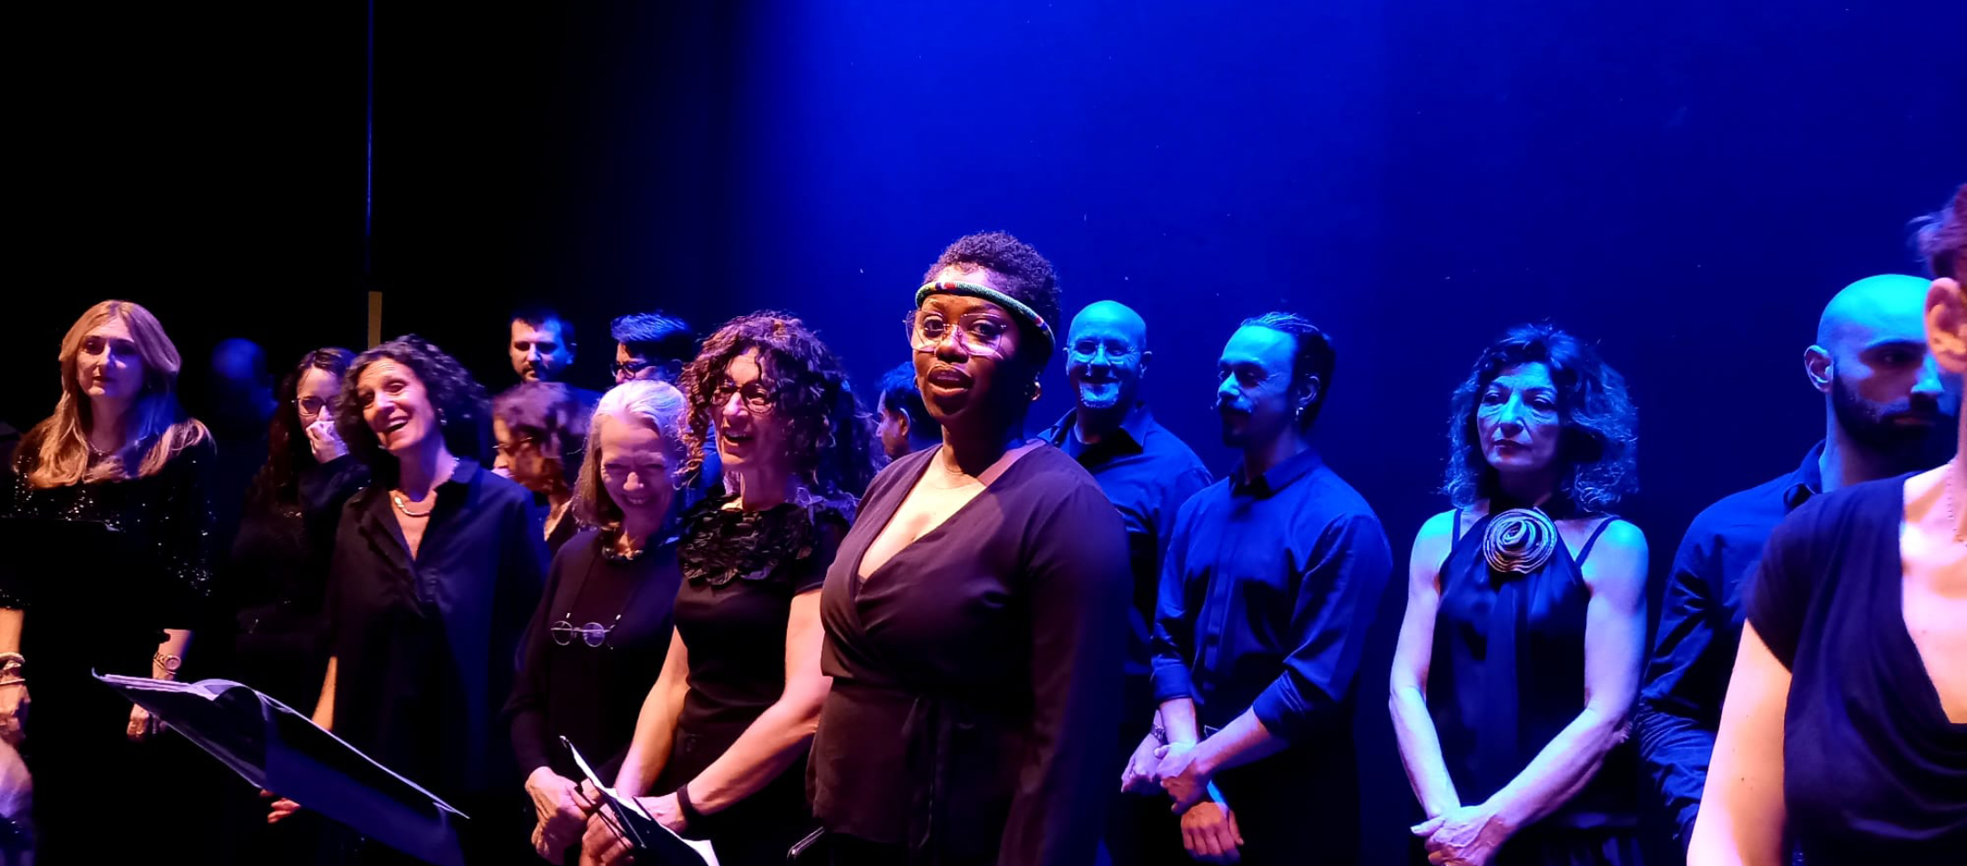

Slide 2
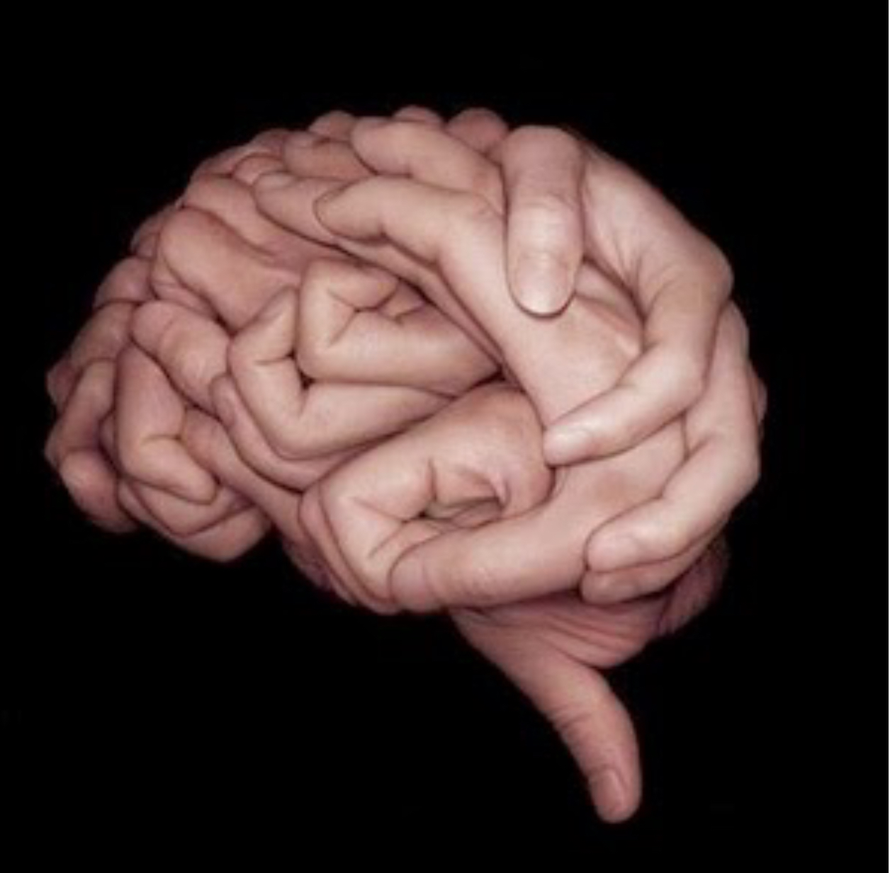
embodied cognition

Slide 3
our students’ needs
neuroscience research
my personal experience

Slide 4
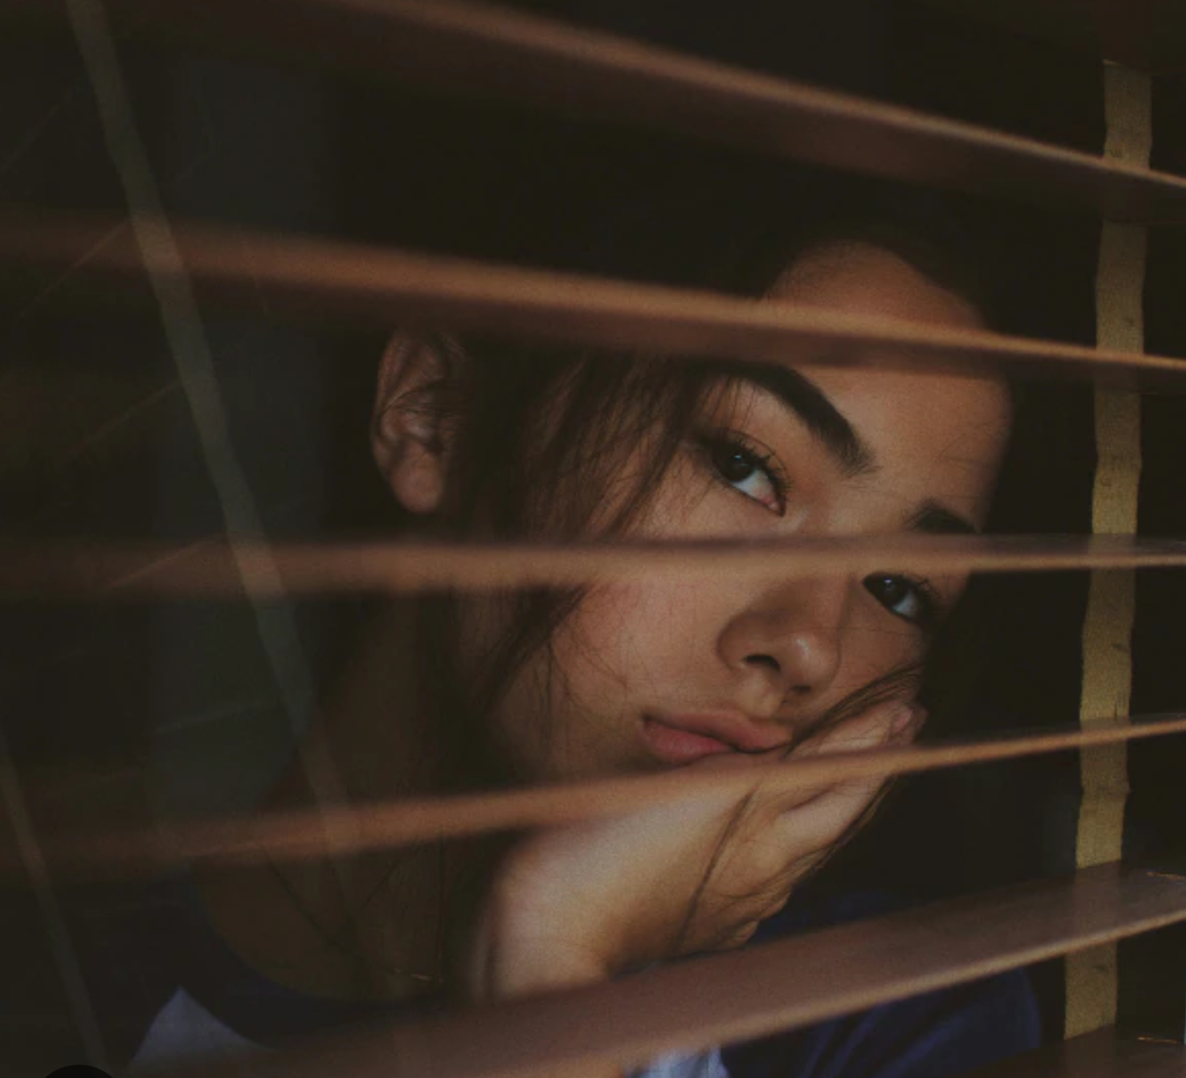
our students’ needs:
sustained attention

Slide 5
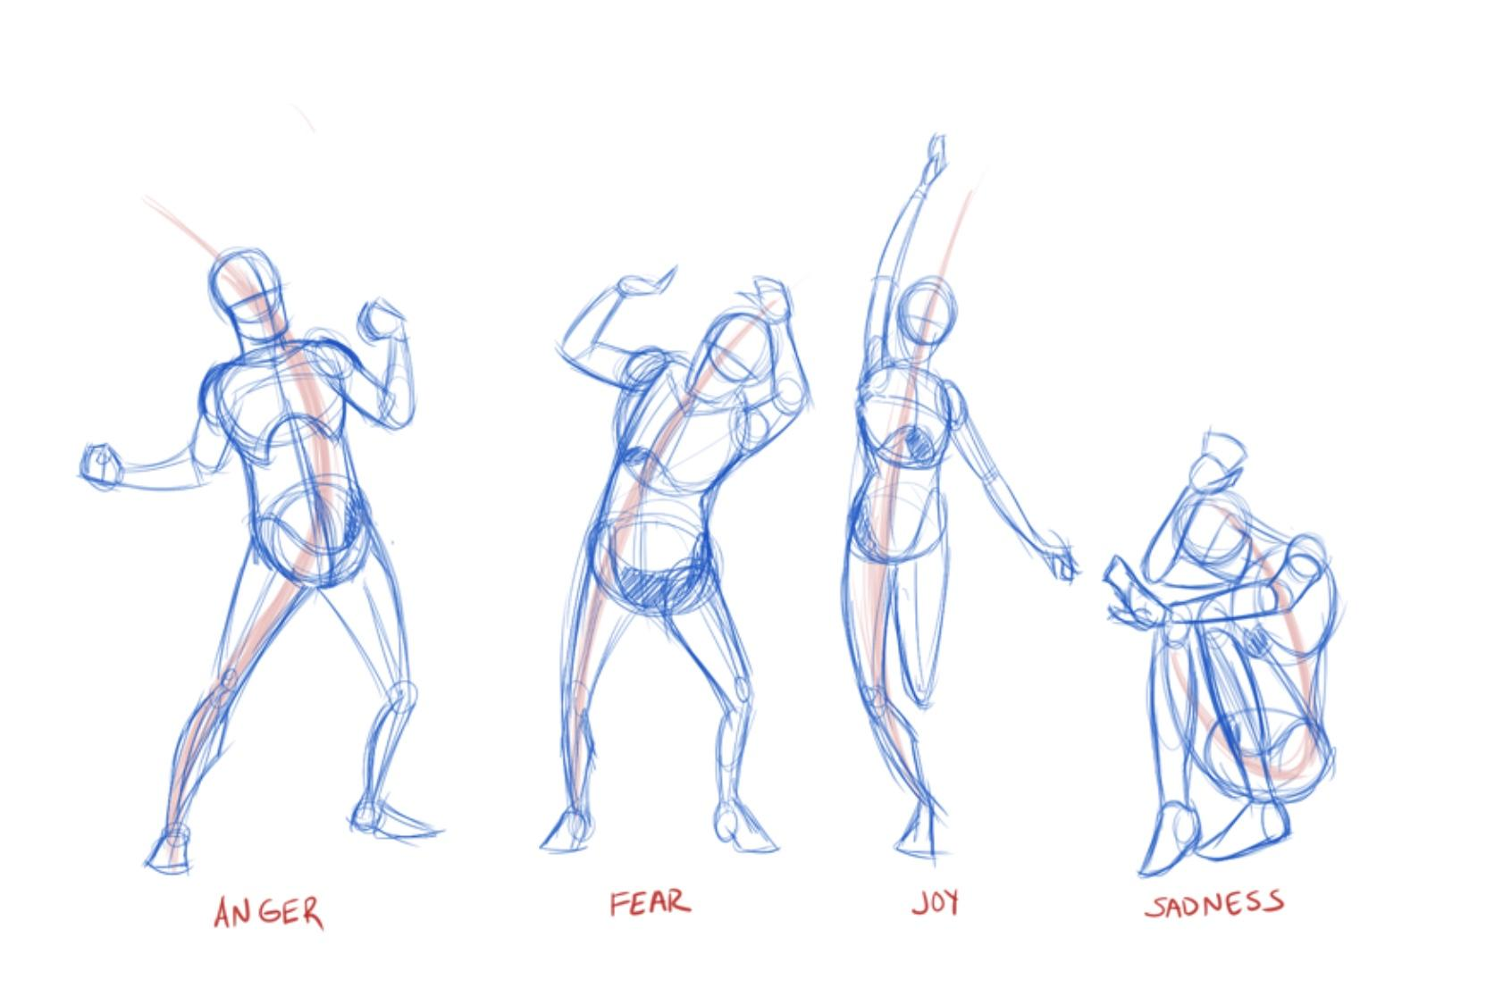
neuroscience research:
to process knowledge we must propose meaningful practical experiences

Slide 6
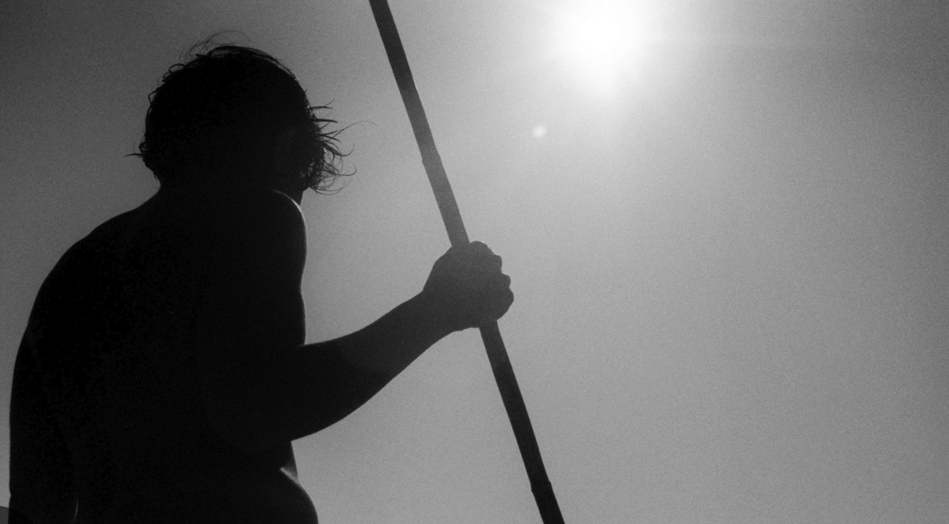
my personal experience
the body never lies

Slide 7





an example…

Slide 8
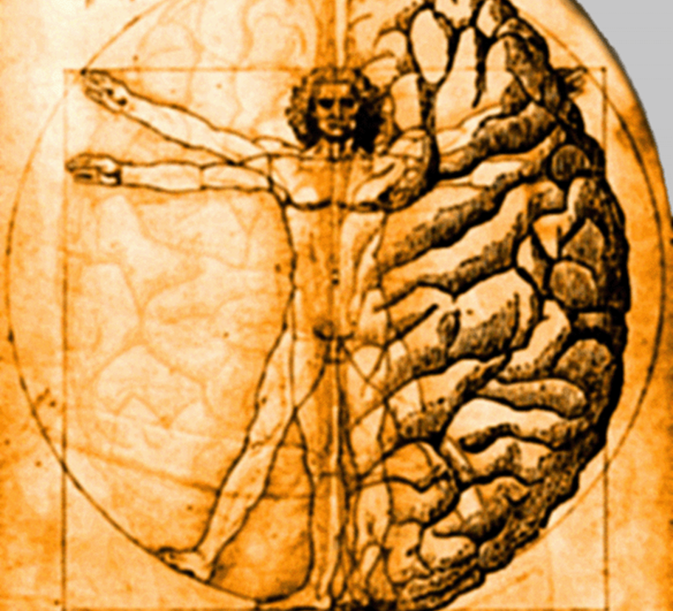
or..

Slide 9
What I hear, I forget.
What I see,I remember.
What I do, I learn.

Slide 10

but… we have a choise..

Slide 11


Slide 12

thank you for your attention

